Slide 1
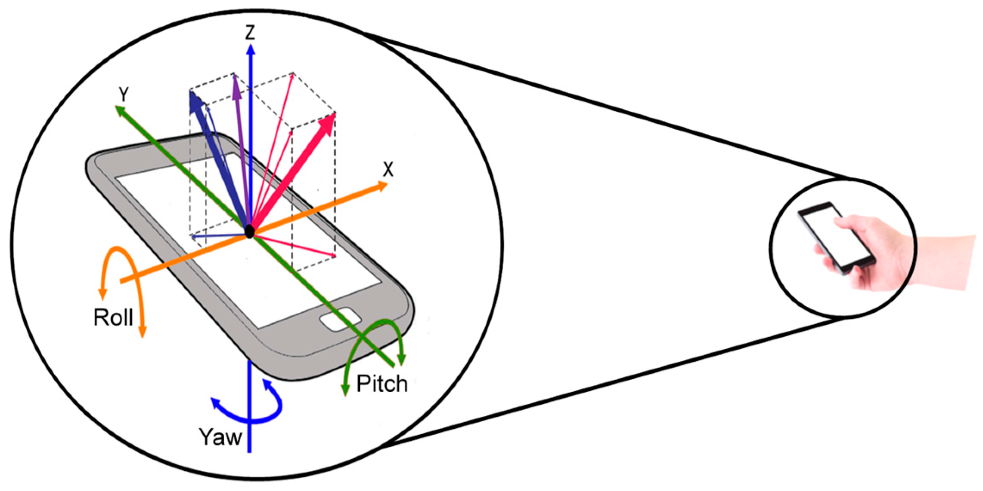
Learning to Detect Heavy Drinking Episodes Using Smartphone Accelerometer Data
Team06:
Karthik Govindappa ( kg667)
Vidhya Venkatesan ( vv256)
Chaitanya Domudala ( cd817)
Mentor :
Dr. James Abello

Slide 2
Introduction

Slide 3
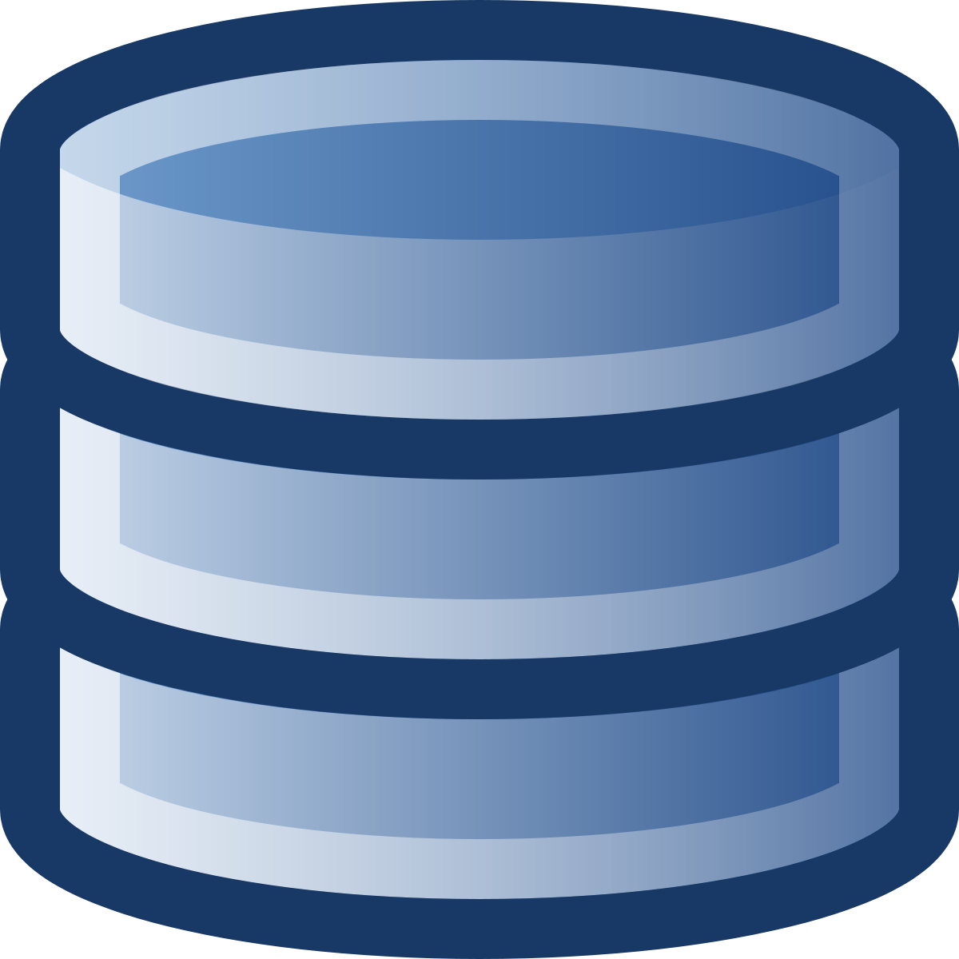
THE DATASET
Raw data size - 8.6 GB
Business.json - 192609 records
Checkin.json - 161950 records
Review.json - 6685900 records
Tip.json - 1223094 records
User.json - 1637138 records
Data at rest
Update frequency : Usually new dataset published
once a year
Data is in CSV Format & parsed as time series data for the model generation.
Dataset Contains 14 million records .
Data Source: https://archive.ics.uci.edu/ml/datasets/Bar+Crawl:+Detecting+Heavy+Drinking

Slide 4
THE DATASET
Raw data size - 8.6 GB
Business.json - 192609 records
Checkin.json - 161950 records
Review.json - 6685900 records
Tip.json - 1223094 records
User.json - 1637138 records
Data at rest
Update frequency : Usually new dataset published
once a year
Data Set Size : 1.2 GB
Number of Instances:
Accelerometer readings: 14,057,567
Participants: 13
all_accelerometer_data_pids_13.csv:
time: integer, unix timestamp, milliseconds
pid: symbolic, 13 categories listed in pids.txt
2) clean_tac/*.csv:
timestamp: integer, unix timestamp, seconds
TAC_Reading: continuous, time-series
3) phone_type.csv:
pid: symbolic, 13 categories listed in pids.txt
phonetype: symbolic, 2 categories (iPhone, Android)
4) raw/*.xlsx:
TAC Level ;IR Voltage; Temperature: continuous, time-series
Time , Date :datetime

Slide 5
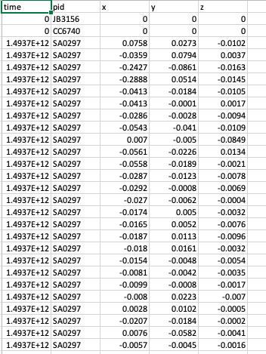
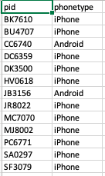
all_accelerometer_data_pids_13.csv
phone_type.csvphone_type.csv
30M accelerometer samples were collected
phone_type.csv
Data File Snippets

Slide 6
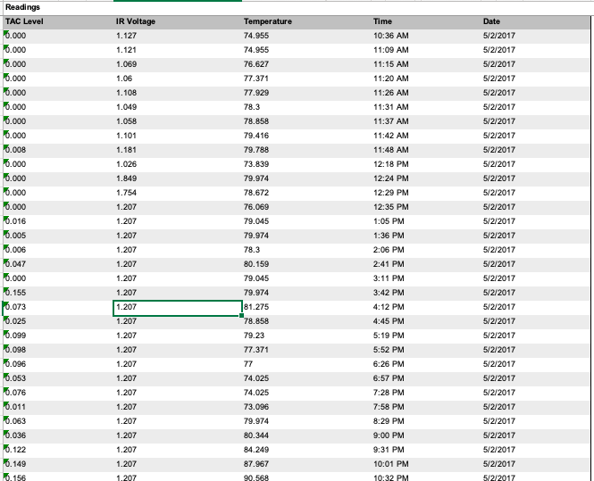
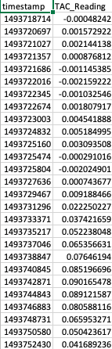
raw/*.xlsx
clean_tac/*.csv
Data File Snippets

Slide 7
KEY
QUESTIONS
Raw data size - 8.6 GB
Business.json - 192609 records
Checkin.json - 161950 records
Review.json - 6685900 records
Tip.json - 1223094 records
User.json - 1637138 records
Data at rest
Update frequency : Usually new dataset published
once a year
How to predict toxic level by use of accelerometer sensor data ?
How to transform the workflow into a spark ML pipeline to make sure it works well with online training and then predicting ?
On what basis Parameter tuning, Feature Selection & Extraction should be performed?
How to setup the streaming platform for the data ?

Slide 8
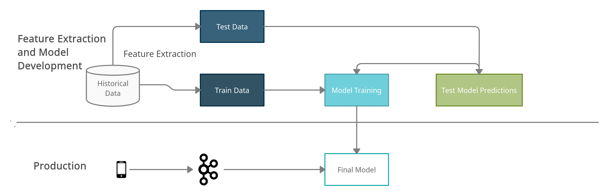
Overview

Slide 9
FEATURE EXTRACTION

Slide 10
Irrelevant Observations are deleted & the data is made uniform.
Time Series is converted to Frequency Data.
Data is structured w.r.t three different axes to strengthen the model accuracy.
Processed 44 features & one output label which corresponds to the TAC reading.
This Processed file is used for model buildup.
Steps Implemented
Notes:
Used Pyaudio analysis library for data cleansing & extracting necessary features.

Slide 11
Mean: Mean represents the average of raw signal.
Max/min: It represents the Max/Min of raw/absolute signal.
Standard Deviation: It represents the standard deviation of raw signal.
Centroid: It represents the weighted mean of frequencies.
Spectral entropy: It represents the Entropy of energy. It has total of two metrics, spectral entropy in frequency domain and spectral entropy in time domain.
Curtosis: It represents the Heaviness of tail/Fourth moment of time-series signal.
Skewness: It represents the Measure of asymmetry of time-series signal.
RMS: It represents the Root-mean-square of accelerations for each axis.
Features Extracted
Notes:
Used Pyaudio analysis library for data cleansing & extracting necessary features.

Slide 12
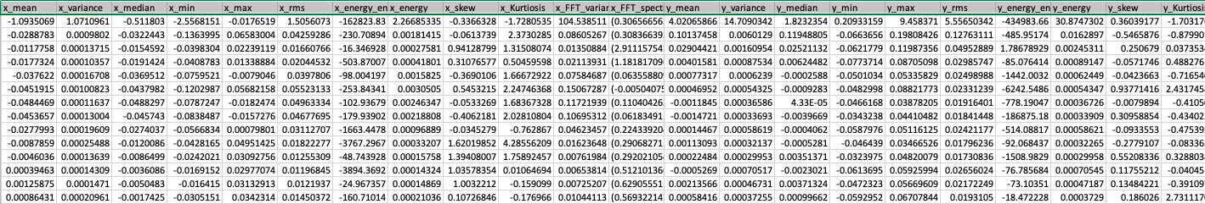
Processed File Snippet
Notes:
All the instances with a TAC value of greater than or equal to the threshold value of 0.08 are labelled as ’1’ and all the instances with TAC value less than 0.08 are labelled as ’0’

Slide 13
MODEL DEVELOPMENT

Slide 14
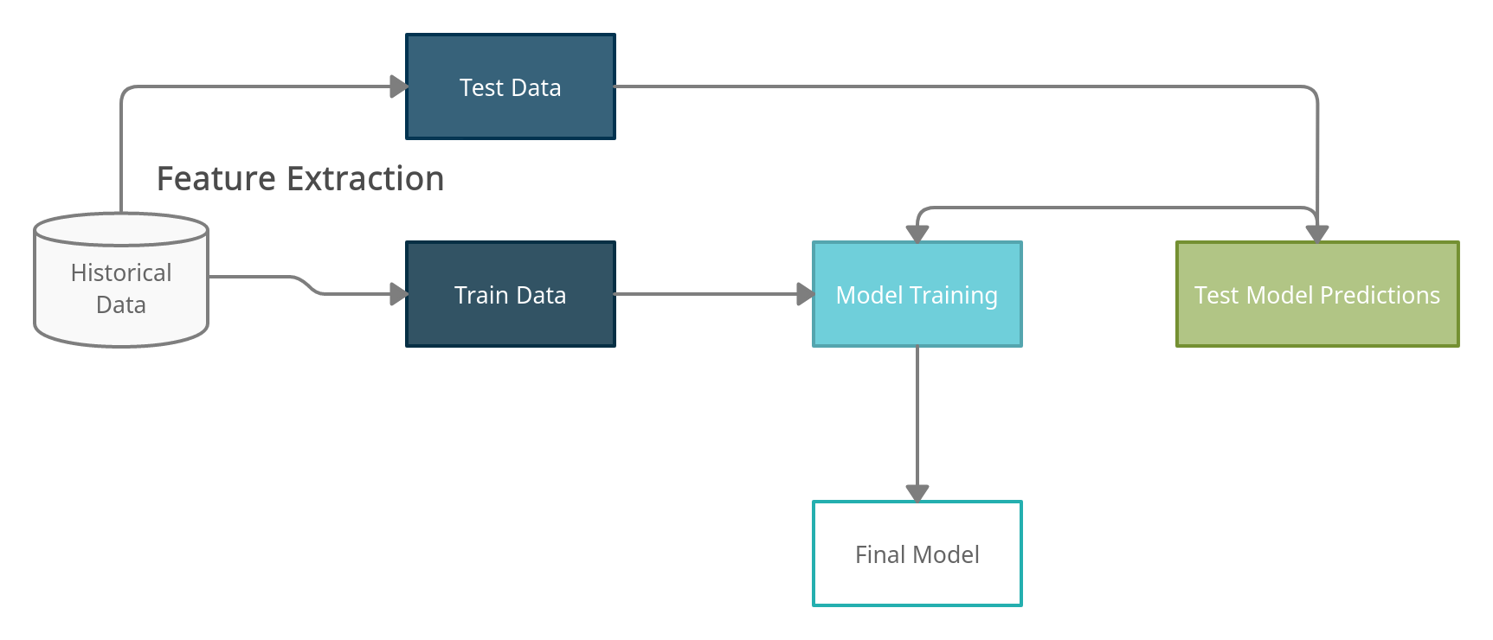
Overview

Slide 15
Used Spark ML libraries to do the model development
The following ML algorithms were tried
Random Forest
Decision Tree
Gradient Boosting
We found that Random forest model was performing relatively well compared to others and we chose it has our final model
Model Preprocessing and Model building was an iterative process involving multiple changes to feature set and hyperparameter tuning
vhj
PROCESS
Notes:
Used Pyaudio analysis library for data cleansing & extracting necessary features.

Slide 16
SPARK ML
Random Forest Classifier
SVM
Frequency Data
Feature Extraction
Windows of 10 sec interval
Time series Data
Architecture ( ML Model Buildup)

Slide 17
PRODUCTION ARCHITECTURE

Slide 18
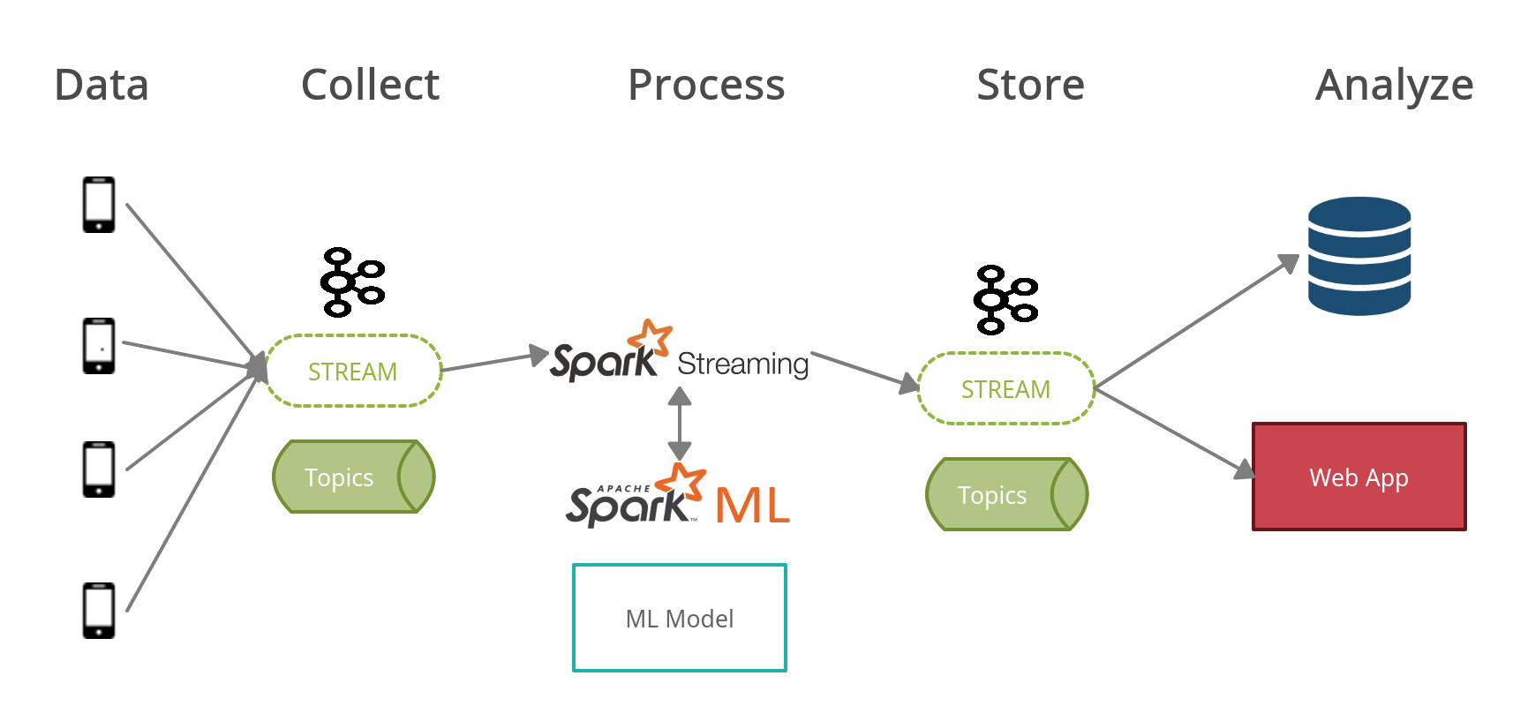
OVERALL ARCHITECTURE

Slide 19
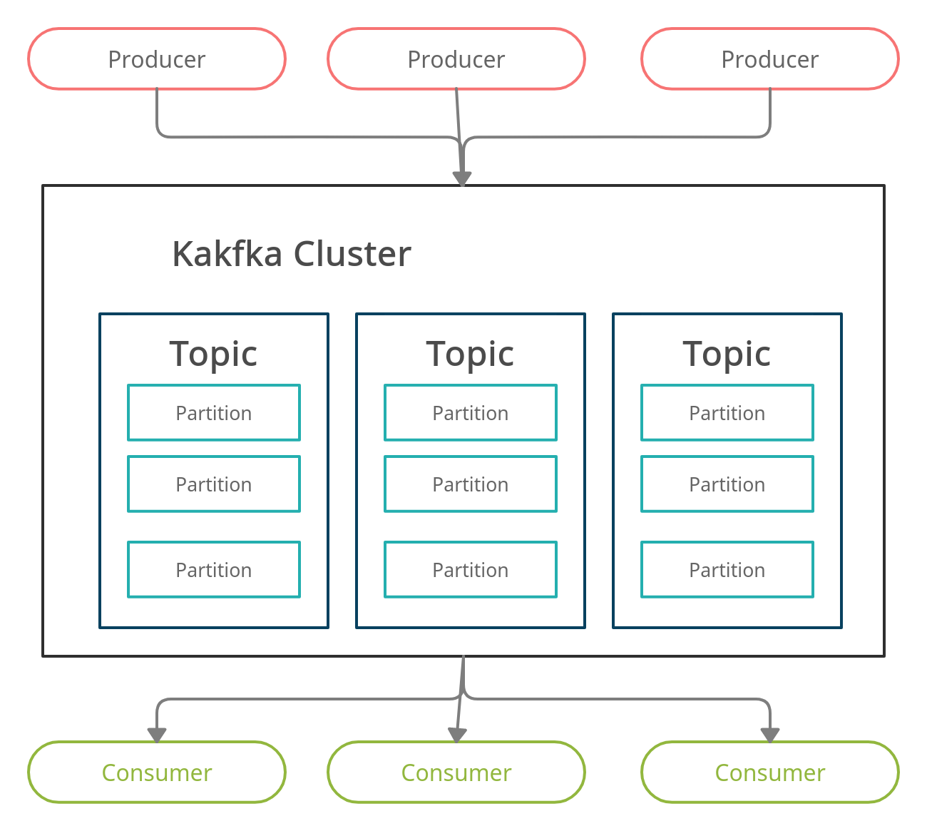
KAFKA OVERVIEW
Apache Kafka is a distributed publish-subscribe messaging system.

Slide 20
KAFKA OVERVIEW
Our Kafka cluster consists of a single server running on Amazon EC2
In our project we have two topics in our kafka cluster
Topic 1: Features
Producer : Data from the Mobile devices
Consumer : Spark Structured Streaming
Topic 2: Preds
Producer : Prediction from the Spark ML
Consumer : Web Applications

Slide 21
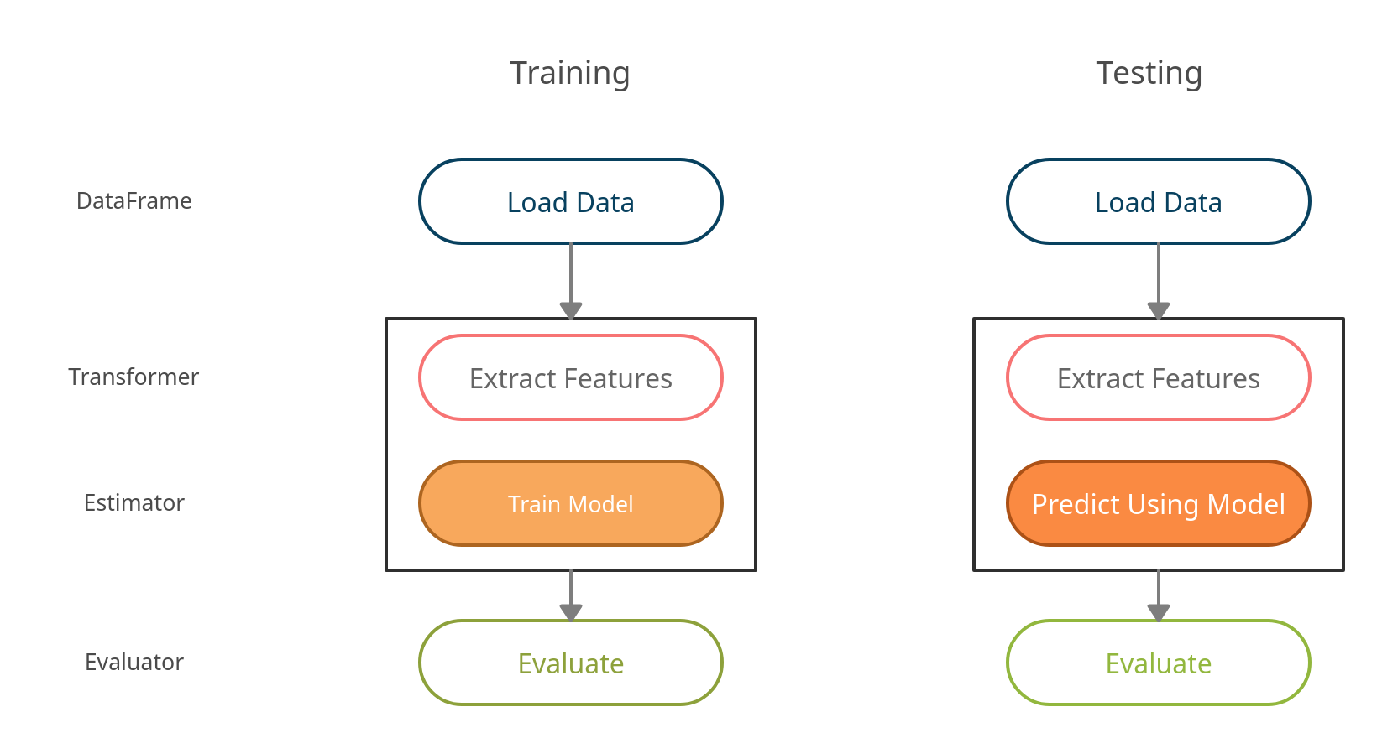
SPARK ML OVERVIEW

Slide 22
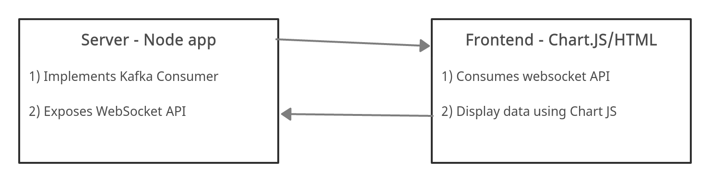
WEB APP

Slide 23
WEB APP - FRONTEND

Slide 24
QUESTIONS
ANSWERED
Raw data size - 8.6 GB
Business.json - 192609 records
Checkin.json - 161950 records
Review.json - 6685900 records
Tip.json - 1223094 records
User.json - 1637138 records
Data at rest
Update frequency : Usually new dataset published
once a year
Questions Answered:
Highly Effective to predict toxic level by use of accelerometer sensor data that is less user dependent.
Feature Selection & Extraction are performed with high tuning to generate high precision results.
pipelined the processed data & fed using kafka workflow for un -interrupted streaming
streaming platform was setup to indicate the level of intoxication. We haven’t implemented the alarm intervention once the reading exceeds the indicated level.

Slide 25
Tools
Algorithms :
RandomForestClassifier implemented using Spark ML libraries
Data Cleaning & Manipulation Activities:
Pandas, Numpy, datetime,PyAudio Analysis are the fundamental package
Data Visualization:
Matplotlib and Seaborn libraries are used
Data Streaming :
Apache Kafka and Spark Streaming
Programming Language:
Python (PySpark,Kafka), Javascript(ChartJS, NodeJS)

Slide 26
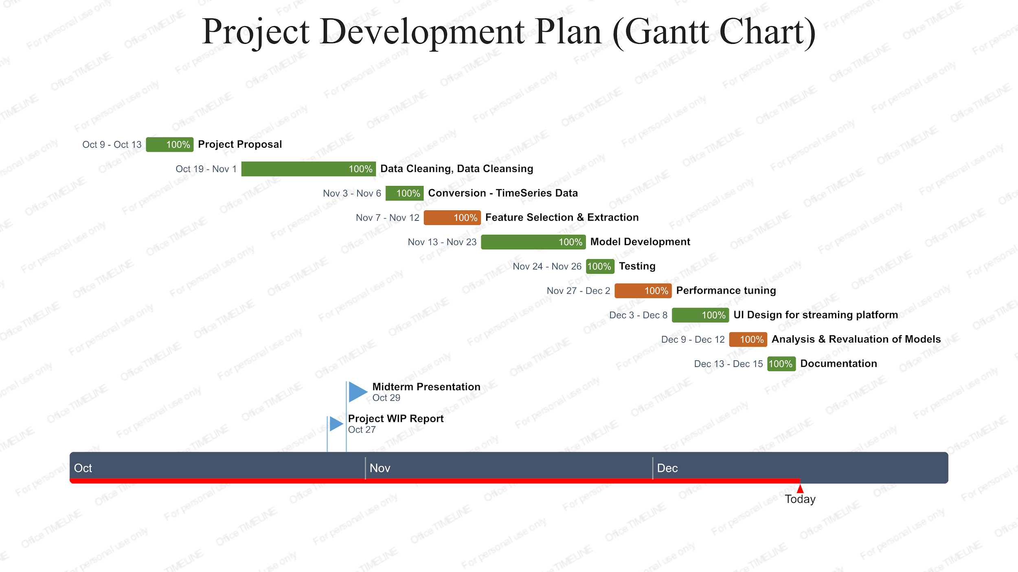

Slide 27
Future Works
& Improvements
Though we achieved a promising level of accuracy, we faced
three important challenges.
First, not controlling for phone placement (pocket, purse, etc.) allowed us to capture more general use-cases, it likely hindered our model’s performance.
Including data from gyroscopes might help alleviate this issue
and while still maintaining anonymity. However, even with more
sensor data more work is needed to incorporate device orientation
before classifications will improve.
We attempted to extract walking events during post-processing, but found that this generally harmed model accuracy.
Using a mobile device’s built-in algorithm for flagging walking data at sensor-time could be a promising direction.
More complex techniques or features capable of modeling the diverse set of user actions in heavy drinking scenarios may be needed.

Slide 28
References
Jackson A Killian & Kevin M Passino & Arnab Nandi & Danielle R Madden1 & John Clapp1 (2019) Learning to Detect Heavy Drinking Episodes Using Smartphone Accelerometer Data KHD@IJCAI .
Jackson A Killian & Kevin M Passino & Arnab Nandi (2018) Smartphone-Based Intelligent System: Training AI to Track Sobriety Using Smartphone Motion Sensors.
[Barnett et al., 2014] Nancy P Barnett, EB Meade, and Tiffany R Glynn. Predictors of detection of alcohol use episodes using a transdermal alcohol sensor. Experimental and clinical psychopharmacology, 22(1):86, 2014.
[Adapa et al., 2018] Apurva Adapa, Fiona Fui-Hoon Nah, Richard H Hall, Keng Siau, and Samuel N Smith. Factors influencing the adoption of smart wearable devices. International Journal of Human–Computer Interaction, 34(5):399–409, 2018.
[Arnold et al., 2015] Zachary Arnold, Danielle LaRose, and Emmanuel Agu. Smartphone inference of alcohol consumption levels from gait. In Healthcare Informatics (ICHI), 2015 International Conference on, pages 417–426. IEEE, 2015.
[Brown-Rice et al., 2015] Kathleen A Brown-Rice, Susan Furr, and Maribeth Jorgensen. Analyzing greek members alcohol consumption by gender and the impact of alcohol education interventions. Journal of Alcohol and Drug Education, 59(1):19–38, 2015.

Slide 29
THANK YOU
Any Questions ??

